Slide 1
Chapter 12 – Simple Linear Regression and Correlation

Slide 2
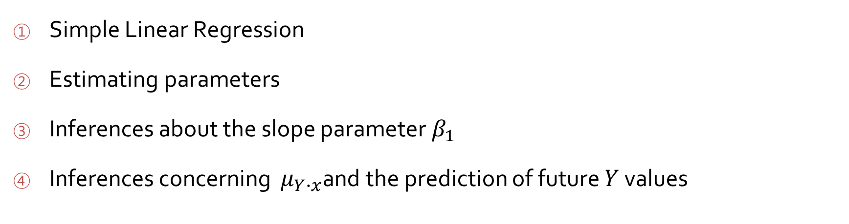
Outline
Simple Linear Regression
Estimating parameters
Inferences about the slope parameter $β_{1}$
Inferences concerning $μ_{Y∙x}$and the prediction of future $Y$ values

Slide 3
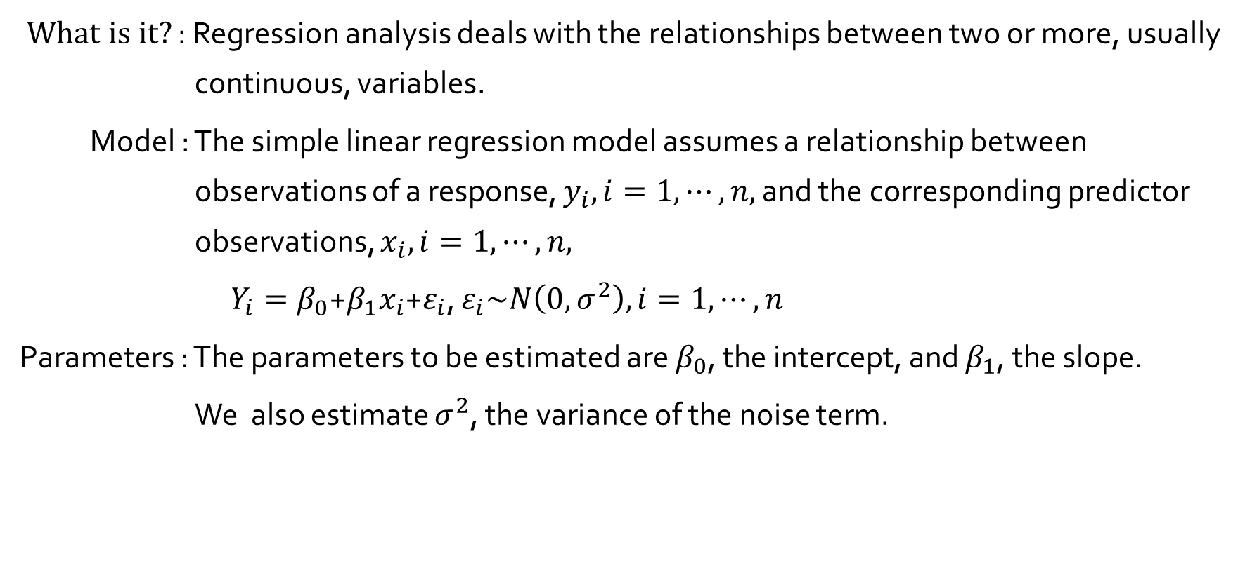
Simple Linear Regression
$What is it?$ : Regression analysis deals with the relationships between two or more, usually continuous, variables.
Model : The simple linear regression model assumes a relationship between observations of a response, $y_{i}, i=1, ⋯, n,$ and the corresponding predictor observations, $x_{i}, i=1, ⋯, n,$
$Y_{i}=β_{0}$+$β_{1}x_{i}$+$ε_{i}$, $ε_{i}\sim N\left(0, σ^{2}\right), i=1, ⋯, n$
Parameters : The parameters to be estimated are $β_{0}$, the intercept, and $β_{1}$, the slope.
We also estimate $σ^{2}$, the variance of the noise term.

Slide 4
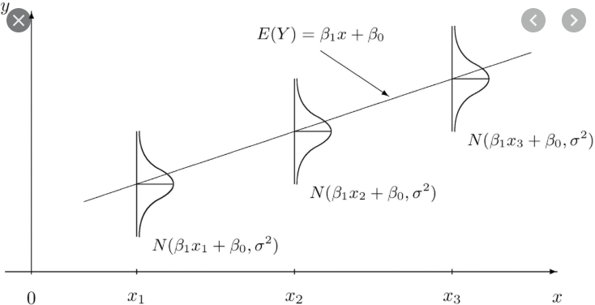
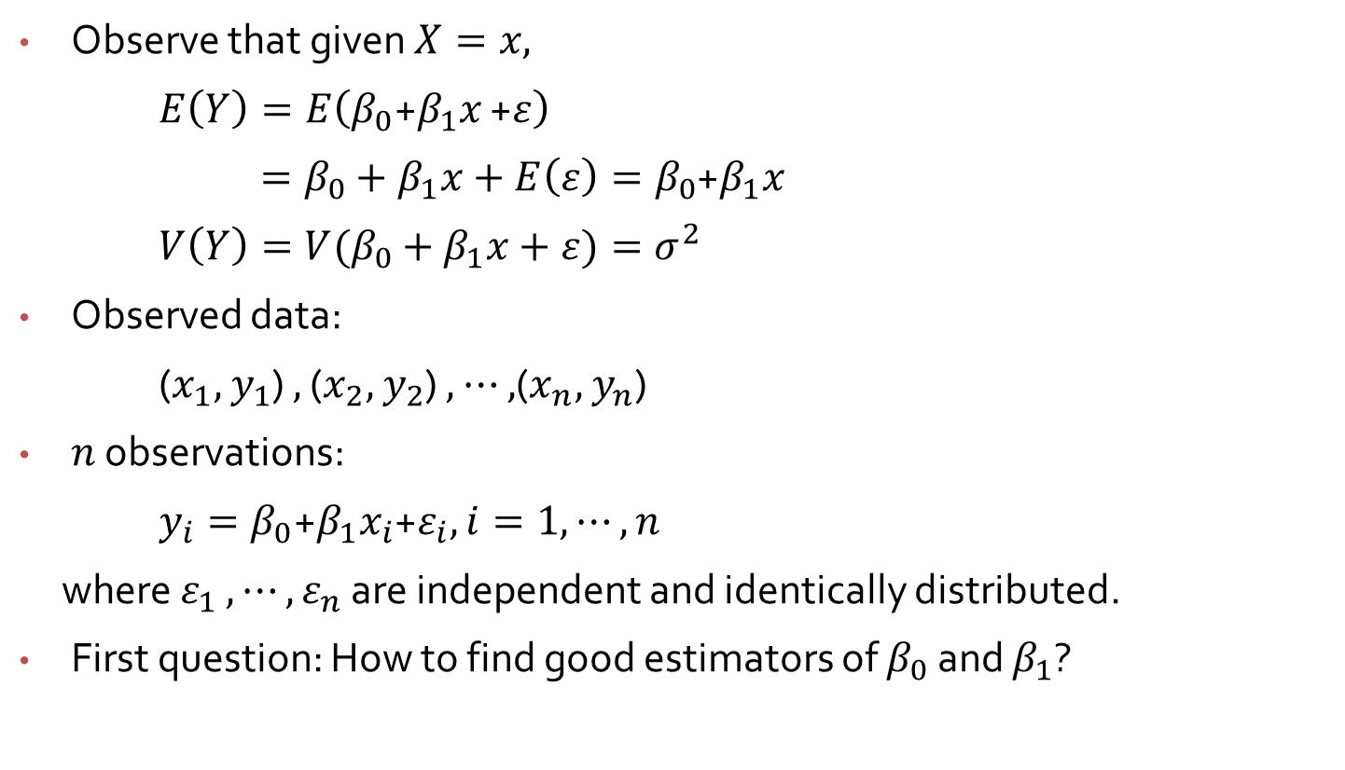
Simple Linear Regression
Observe that given $X=x,$
$E\left(Y\right)=E\left(β_{0}\text{+}β_{1}x\text{ +}ε\right)$
$=β_{0}$ $+ β_{1}x+E\left(ε\right)=β_{0}$+$β_{1}x$
$V\left(Y\right)={V(β}_{0}$ $+ β_{1}x+ε)=σ^{2}$
Observed data:
($x_{1},$ $y_{1}$) $,$ ($x_{2},$ $y_{2}$) $,$ $⋯$ $,$($x_{n},$ $y_{n}$)
$n$ observations:
$y_{i}=β_{0}$+$β_{1}x_{i}$+$ε_{i},i=1, ⋯, n$
where $ε_{1}$ $, ⋯, ε_{n}$ are independent and identically distributed.
First question: How to find good estimators of $β_{0}$ and $β_{1}$?

Slide 5
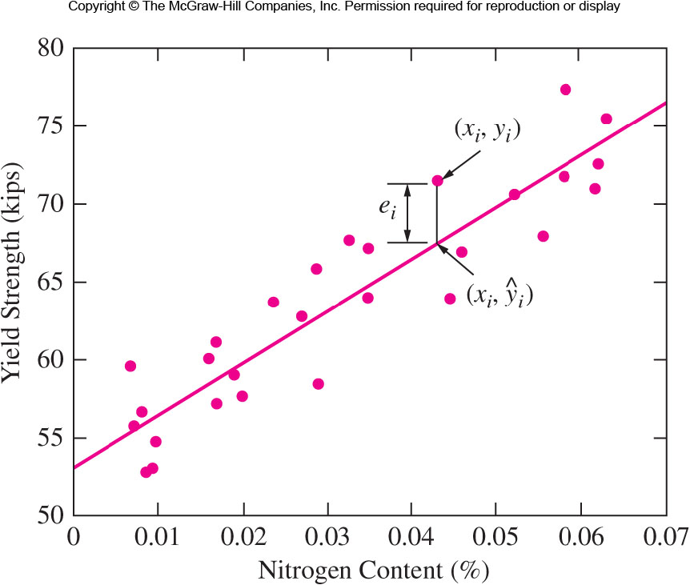

Figure 2.7 Yield strength versus nitrogen content for a sample of welds
$${\hat{y}}_{i}={\hat{β}}_{0}+{\hat{β}}_{1}x_{i}$$

Slide 6
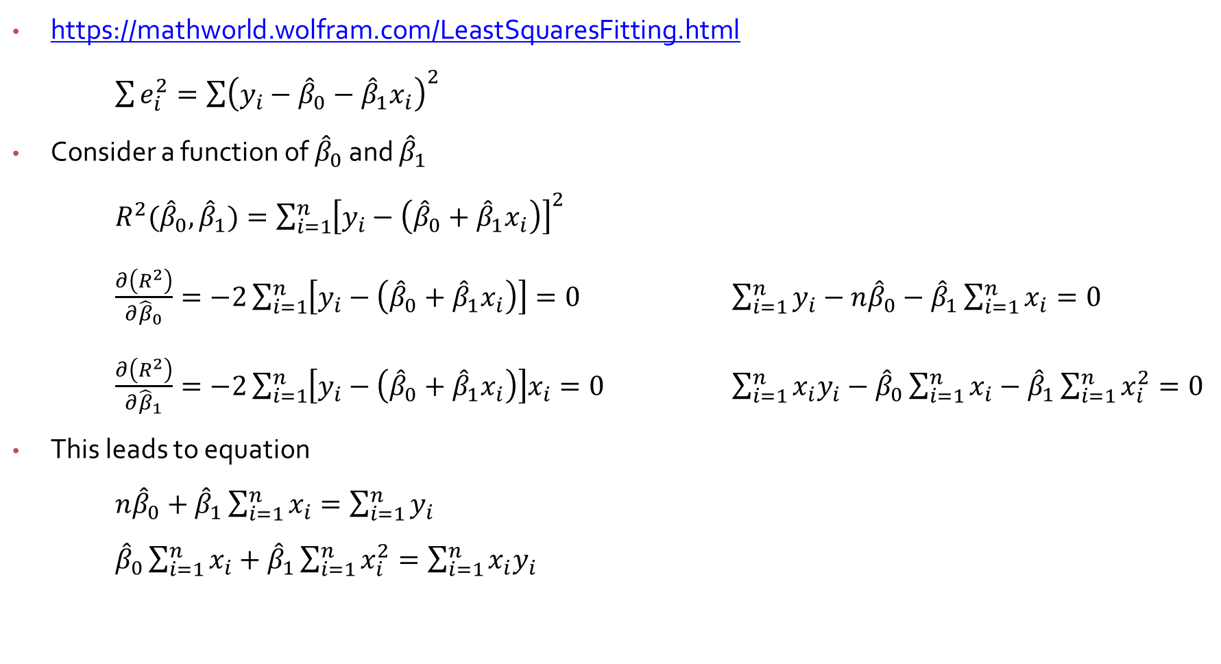
Method of Least Squares (MLS)
https://mathworld.wolfram.com/LeastSquaresFitting.html
$\sum{e_{i}^{2}}=\sum{{\left(y_{i}−{\hat{β}}_{0}−{\hat{β}}_{1}x_{i}\right)}^{2}}$
Consider a function of ${\hat{β}}_{0}$ and ${\hat{β}}_{1}$
$R^{2}({\hat{β}}_{0},{\hat{β}}_{1})=\sum_{i=1}^{n}{{\left[y_{i}−\left({\hat{β}}_{0}+{\hat{β}}_{1}x_{i}\right)\right]}^{2}}$
$\frac{∂\left(R^{2}\right)}{∂{\hat{β}}_{0}}=−2\sum_{i=1}^{n}{\left[y_{i}−\left({\hat{β}}_{0}+{\hat{β}}_{1}x_{i}\right)\right]}=0$ $\sum_{i=1}^{n}{y_{i}}−n{\hat{β}}_{0}−{\hat{β}}_{1}\sum_{i=1}^{n}{x_{i}}=0$
$\frac{∂\left(R^{2}\right)}{∂{\hat{β}}_{1}}=−2\sum_{i=1}^{n}{\left[y_{i}−\left({\hat{β}}_{0}+{\hat{β}}_{1}x_{i}\right)\right]x_{i}}=0$ $\sum_{i=1}^{n}{{x_{i}y}_{i}}−{\hat{β}}_{0}\sum_{i=1}^{n}{x_{i}}−{\hat{β}}_{1}\sum_{i=1}^{n}{x_{i}^{2}}=0$
This leads to equation
$n{\hat{β}}_{0}+{\hat{β}}_{1}\sum_{i=1}^{n}{x_{i}}=\sum_{i=1}^{n}{y_{i}}$
${\hat{β}}_{0}\sum_{i=1}^{n}{x_{i}}+{\hat{β}}_{1}\sum_{i=1}^{n}{x_{i}^{2}}=\sum_{i=1}^{n}{{x_{i}y}_{i}}$

Slide 7
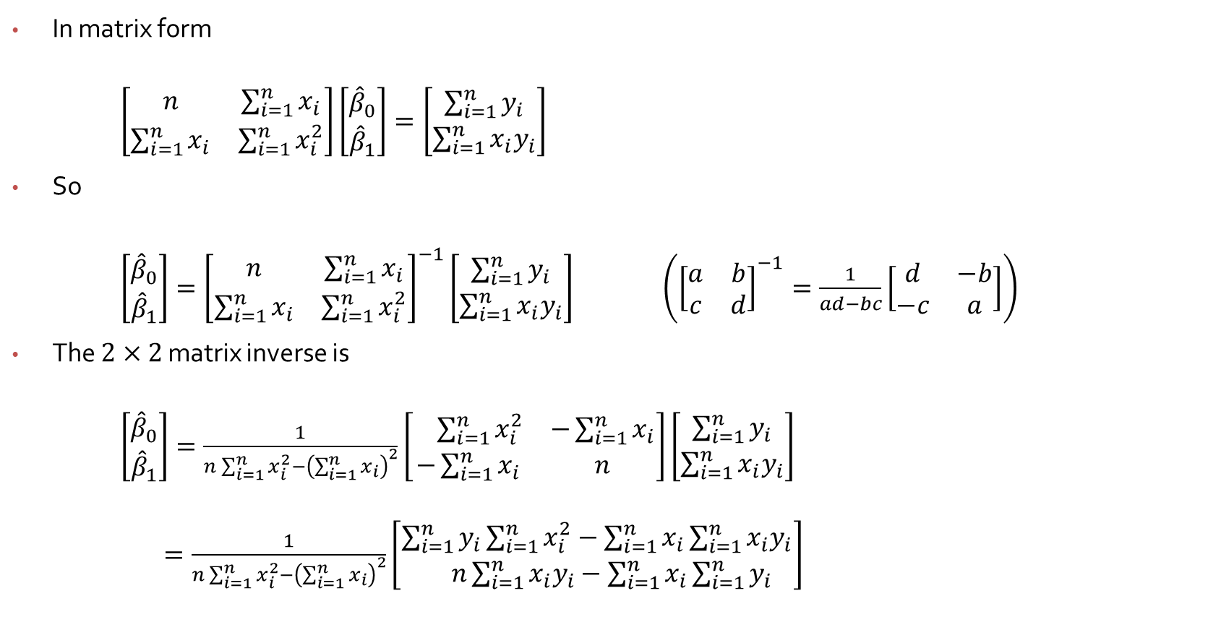

Derivation of ${\hat{β}}_{0}$ and ${\hat{β}}_{1}$
In matrix form
$\left[\begin{matrix}n & \sum_{i=1}^{n}{x_{i}} \\ \sum_{i=1}^{n}{x_{i}} & \sum_{i=1}^{n}{x_{i}^{2}}\end{matrix}\right]\left[\begin{matrix}{\hat{β}}_{0} \\ {\hat{β}}_{1}\end{matrix}\right]=\left[\begin{matrix}\sum_{i=1}^{n}{y_{i}} \\ \sum_{i=1}^{n}{{x_{i}y}_{i}}\end{matrix}\right]$
So
$\left[\begin{matrix}{\hat{β}}_{0} \\ {\hat{β}}_{1}\end{matrix}\right]={\left[\begin{matrix}n & \sum_{i=1}^{n}{x_{i}} \\ \sum_{i=1}^{n}{x_{i}} & \sum_{i=1}^{n}{x_{i}^{2}}\end{matrix}\right]}^{−1}\left[\begin{matrix}\sum_{i=1}^{n}{y_{i}} \\ \sum_{i=1}^{n}{{x_{i}y}_{i}}\end{matrix}\right]$ $\left({\left[\begin{matrix}a & b \\ c & d\end{matrix}\right]}^{−1}=\frac{1}{ad−bc}\left[\begin{matrix}d & −b \\ −c & a\end{matrix}\right]\right)$
The $2×2$ matrix inverse is
$\left[\begin{matrix}{\hat{β}}_{0} \\ {\hat{β}}_{1}\end{matrix}\right]=\frac{1}{n\sum_{i=1}^{n}{x_{i}^{2}}−{\left(\sum_{i=1}^{n}{x_{i}}\right)}^{2}}\left[\begin{matrix} \sum_{i=1}^{n}{x_{i}^{2}} & −\sum_{i=1}^{n}{x_{i}} \\ −\sum_{i=1}^{n}{x_{i}} & n\end{matrix}\right]\left[\begin{matrix}\sum_{i=1}^{n}{y_{i}} \\ \sum_{i=1}^{n}{{x_{i}y}_{i}}\end{matrix}\right]$
$=\frac{1}{n\sum_{i=1}^{n}{x_{i}^{2}}−{\left(\sum_{i=1}^{n}{x_{i}}\right)}^{2}}\left[\begin{matrix}\sum_{i=1}^{n}{y_{i}}\sum_{i=1}^{n}{x_{i}^{2}}−\sum_{i=1}^{n}{x_{i}\sum_{i=1}^{n}{{x_{i}y}_{i}}} \\ n\sum_{i=1}^{n}{{x_{i}y}_{i}}−\sum_{i=1}^{n}{x_{i}\sum_{i=1}^{n}{y_{i}}}\end{matrix}\right]$

Slide 8


Derivation of ${\hat{β}}_{0}$ and ${\hat{β}}_{1}$
So
${\hat{β}}_{0}=\frac{\sum_{i=1}^{n}{y_{i}}\sum_{i=1}^{n}{x_{i}^{2}}−\sum_{i=1}^{n}{x_{i}\sum_{i=1}^{n}{{x_{i}y}_{i}}}}{n\sum_{i=1}^{n}{x_{i}^{2}}−{\left(\sum_{i=1}^{n}{x_{i}}\right)}^{2}}$ ($\overline{x}=\frac{\sum_{i=1}^{n}{x_{i}}}{n}$)
$=\frac{\overline{y}\sum_{i=1}^{n}{x_{i}^{2}}−\overline{x}\sum_{i=1}^{n}{{x_{i}y}_{i}}}{\sum_{i=1}^{n}{x_{i}^{2}}−n{\overline{x}}^{2}}$
${\hat{β}}_{1}=\frac{n\sum_{i=1}^{n}{{x_{i}y}_{i}}−\sum_{i=1}^{n}{x_{i}}\sum_{i=1}^{n}{y_{i}}}{n\sum_{i=1}^{n}{x_{i}^{2}}−{\left(\sum_{i=1}^{n}{x_{i}}\right)}^{2}}$
$=\frac{\left(\sum_{i=1}^{n}{{x_{i}y}_{i}}\right)−n\overline{x}\overline{y}}{\sum_{i=1}^{n}{x_{i}^{2}}−n{\overline{x}}^{2}}$ $=\frac{\sum_{i=1}^{n}{\left(x_{i}−\overline{x}\right)\left(y_{i}−\overline{y}\right)}}{\sum_{i=1}^{n}{{\left(x_{i}−\overline{x}\right)}^{2}}}$
($\sum_{i=1}^{n}{\left(x_{i}−\overline{x}\right)\left(y_{i}−\overline{y}\right)}=$ $\sum_{i=1}^{n}{{x_{i}y}_{i}−}\overline{y}\sum_{i=1}^{n}{x_{i}}−\overline{x}\sum_{i=1}^{n}{y_{i}}+n\overline{x}\overline{y}$
$=\sum_{i=1}^{n}{{x_{i}y}_{i}−}n\overline{x}\overline{y}−n\overline{x}\overline{y}+n\overline{x}\overline{y}=\left(\sum_{i=1}^{n}{{x_{i}y}_{i}}\right)−n\overline{x}\overline{y}$ )
${\hat{β}}_{0}=\overline{y}−{\hat{β}}_{1}\overline{x}$

Slide 9
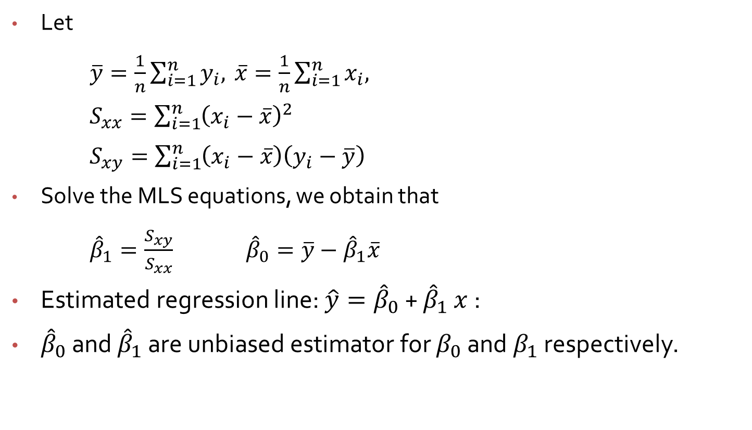
Method of Least Squares (MLS)
Let
$\overline{y}=\frac{1}{n}\sum_{i=1}^{n}{y_{i},}$ $\overline{x}=\frac{1}{n}\sum_{i=1}^{n}{x_{i},}$
$S_{xx}=\sum_{i=1}^{n}{{\left(x_{i}−\overline{x}\right)}^{2}}$
$S_{xy}=\sum_{i=1}^{n}{\left(x_{i}−\overline{x}\right)\left(y_{i}−\overline{y}\right)}$
Solve the MLS equations, we obtain that
${\hat{β}}_{1}=\frac{S_{xy}}{S_{xx}}$ ${\hat{β}}_{0}=\overline{y}−{\hat{β}}_{1}\overline{x}$
Estimated regression line: $\hat{y}={\hat{β}}_{0}$ + ${\hat{β}}_{1}$ $x$:
${\hat{β}}_{0}$ and ${\hat{β}}_{1}$ are unbiased estimator for $β_{0}$ and $β_{1}$ respectively.

